Slide 1
Master Dissertation Defense
Use of ARM Multicore Cluster for High Performance Scientific Computing
(계산과학을 위한 고성능 ARM 멀티코어 클러스터 활용)
Date: 2014-06-10 Tue: 10:45 AM
Place: Paldal Hall 1001
Presenter: Jahanzeb Maqbool Hashmi
Adviser: Professor Sangyoon Oh

Slide 2
Agenda
Introduction
Related Work & Shortcomings
Problem Statement
Contribution
Evaluation Methodology
Experiment Design
Benchmark and Analysis
Conclusion
References
Q&A

Slide 3
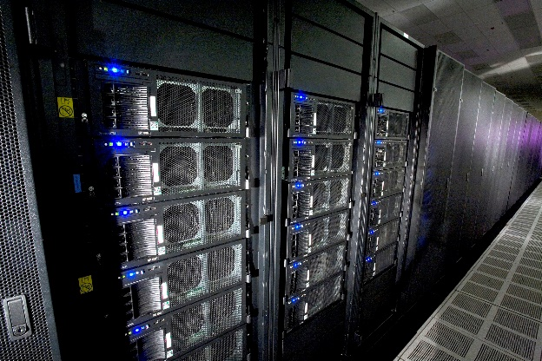

Introduction
2008 IBM Roadrunner
1 PetaFlop supercomputer
Next milestone
1 ExaFlop by 2018
DARPA budget ~20 MW
Energy Efficiency of ~50 GFlop/W is required
Power consumption problem
Tianhe-II – 33.862 PetaFlop
17.8 MW power – equal to power plant

Slide 4
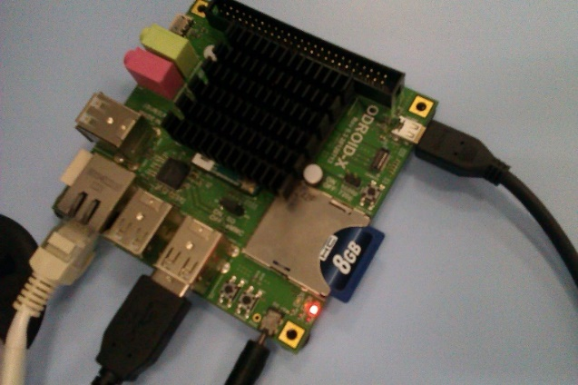
Introduction
Power breakdown
Processor 33%
Energy efficient architectures are required
Low power ARM SoC
Used in mobile industry
0.5 - 1.0 Watt per core
1.0 - 2.5 GHz clock speed
Mont Blanc project
ARM cluster prototypes
Tibidabo - 1st ARM based cluster (Rajovic et al. [6])

Slide 5
Related Studies
Ou et al [9] – server benchmarking
in memory DB, web server
single node evaluation
Kevile et al [23] – ARM emulation VM on the cloud
No real-time application performance
Stanley et al [21] – analyzed thermal constraints on processors
Lightweight workloads
Edson et al [22] – BeagleBoard vs PandaBoard
No HPC benchmarks
Focus on SoCs comparison
Jarus et al [24] – Vendor comparison
RISC vs. CISC energy efficiency

Slide 6
Motivation
Application classes to evaluate 1 Exaflop supercomputer
Molecular dynamic, n-body simulation, finite element solvers (Bhatele et al [10])
Existing studies fell short in delivering insights on HPC eval.
Lack of HPC representative benchmarks (HPL, NAS, PARSEC)
Large-scale simulation scalability in terms of Amdahl’s law
Parallel overhead in terms of computation and communication
Lack of insights on the performance of programming models
Distributed Memory (MPI-C vs MPI-Java)
Shared Memory (multithreading, OpenMP)
Lack of insights on Java based scientific computing
Java is already well established language in parallel computing

Slide 7
Problem Statement
Research Problem
A large gap lies in terms of insights on HPC representative applications performance and parallel programming models on ARM-HPC.
Existing approaches, so far, fell short to give these insights
Objective
Provide a detailed survey of HPC benchmarks, large-scale applications, and programming models performance
Discuss single node and cluster performance of ARM SoCs
Discuss the possible optimizations for Cortex-A9

Slide 8
Contribution
A systematic evaluation methodology for single-node and multi-node performance evaluation of ARM
HPC representative benchmarks (NAS, HPL, PARSEC)
n-body simulation (Gadget-2)
Parallel programming models (MPI, OpenMP, MPJ)
Optimizations to achieve better FPU performance on ARM Cortex-A9
321 Mflops/W on Weiser
2.5 times better GFlops
A detailed survey of C and Java based HPC on ARM
Discussion on different performance metrics
PPW and Scalability (parallel speedup)
I/O bound vs. CPU bound application performance

Slide 9
Evaluation Methodology
Single node evaluation
STREAM – Memory bandwidth
Baseline for other shared memory benchmarks
Sysbench – MySQL batch transaction processing (INSERT, SELECT)
PARSEC shared memory benchmark – two application classes
Black-Scholes – Financial option pricing
Fluidanimate – Computational Fluid Dynamics
Cluster evaluation
Latency & Bandwidth – MPICH vs. MPJ-Express
Baseline for other distributed memory benchmarks
HPL – BLAS kernels
Gadget-2 – large-scale n-body cluster formation simulation
NPB – computational kernels by NASA

Slide 10
Experimental Design [1/2]
ODROID X SOC
ARM Cortex-A9 processor
4 cores @ 1.4 GHz
Weiser cluster
Beowulf cluster of ODROID-X
16 nodes (64 cores)
16GB of total RAM
Shared NFS storage
MPI libraries installed
MPICH
MPJ-Express (modified)
ODROID-X ARM SoC board and Intel x86 Server Configuration
 | ODROID-X SoC | Intel Server
Processor | Samsung Exynos 4412 | Intel Xeon x3430
Lithography | 32nm | 32nm
L2 Cache | 1M | 256K
No. of cores | 4 | 4
Clock Speed | 1.4 GHz | 2.40 GHz
Instruction Set | 32-bit | 64-bit
Main memory | 1GB DDR2 @ 800 MHz | 8 GB DDR3 @ 1333 MHz
Kernel version | 3.6.1 | 3.6.1
Compiler | GCC 4.6.3 | GCC 4.6.3

Slide 11
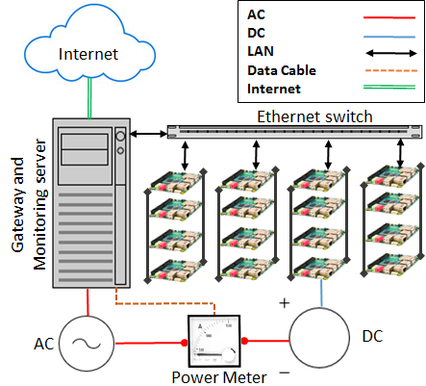

Experimental Design [2/2]
Power Measurement
Green500 approach by using Linpack benchmark
: Max GFlop/s
: No. of nodes
: power of single node
ADPower Wattman PQA-2000 power meter
Peak instantaneous power
recorded.
Custom built Weiser cluster of ARM boards

Slide 12
Benchmarks and Analysis
Message Passing Java on ARM
Java has become a mainstream language for parallel programming
MPJ-Express on ARM cluster to enable Java based benchmarking on ARM
Previously, no Java-HPC evaluation is done on ARM
Changes in MPJ-Express source code (Appendix. A)
Java Service Wrapper binaries for ARM Cortex-A9 are added.
Scripts to start/stop daemons (mpjboot, mpjhalt) on remote machines are changed.
New scripts to launch mpjdaemon on ARM are added.

Slide 13
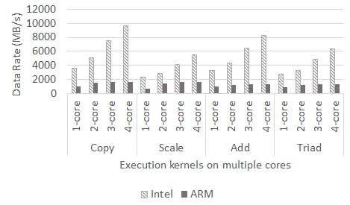
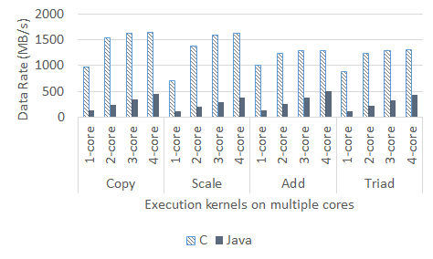
Single Node Evaluation [STREAM]
Memory Bandwidth comparison of Cortex-A9 and x86 server
Baseline for other evaluation benchmarks
X86 outperformed Cortex-A9 by factor of ~4.
Limited Bus (800 vs. 1333) MHz
STREAM-C and STREAM-Java performance on Cortex-A9
language specific memory management
~3 times better performance on C based implementation.
Poor JVM support for ARM
emulated floating point
STREAM-C kernels on x86 and Cortex-A9
STREAM-C and STREAM-Java on ARM
Notes:
ARM is behind x86 server in raw bandwidth because of its smaller bus and slower clock. Also, unoptimized JVM cause degrading performance in Java performance as compared to C based implementation.

Slide 14
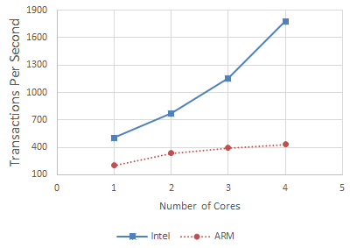
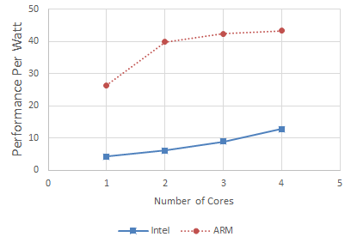
Single Node Evaluation [OLTP]
Transactions Per Second
Intel x86 performs better in raw performance
Serial 60% increase
4-cores 230% increase
Bigger cache, fewer bus access
Transactions/sec Per Watt
4-cores 3 time better PPW
Multicore scalability
40% from 1 to 2 cores
10% from 3 to 4 cores
ARM outperforms x86 server
Transactions/second (Raw Performance)
Transaction/second per Watt (Energy-Efficiency)
Notes:
ARM Cortex-A9 showed ~3 times better energy-efficiency as compared to commodity x86_64 server in DB transactions test

Slide 15
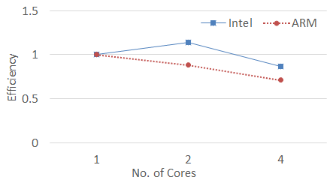

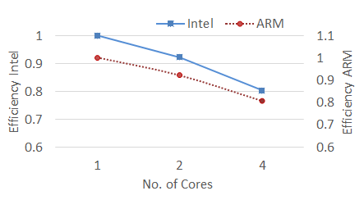
Single Node Evaluation [PARSEC]
Multithreaded performance
Amdahl’s law of parallel efficiency:
[37]
Parallel overhead by increasing # of cores
Black-Scholes
Embarrassingly parallel
CPU bound – minimal overhead
2-cores : 1.2x
4-cores : 0.78x
Fluidanimate
I/O bound – large communication overhead
Similar efficiency for ARM and x86
2 cores : 0.9
4 cores : 0.8 (on both)
Black-Scholes strong scaling (multicore)
Fluid-animate strong scaling (multicore)
Notes:
Even though Intel x86 server has better raw performance but ARM has good parallel efficiency in CPU bound and I/O bound applications
How close the speedup is to the ideal speedup for n-cores on a given architecture
-- closer to 1 means ideal speedup, no matter how much cores are used
Raw performance is not equal
Scaling efficiency of ARM depends on the application class (CPU bound or I/O bound). However, in both cases, it showed comparable performance to Intel x86 server.

Slide 16
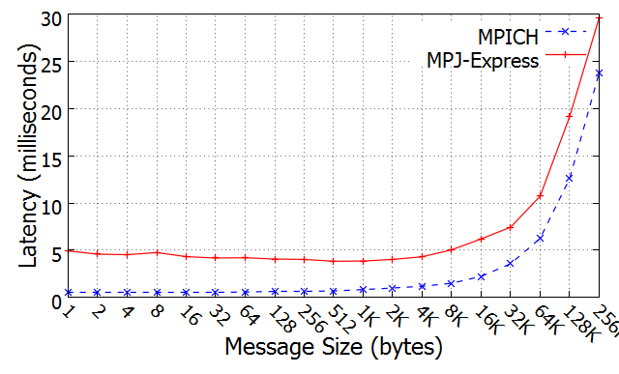
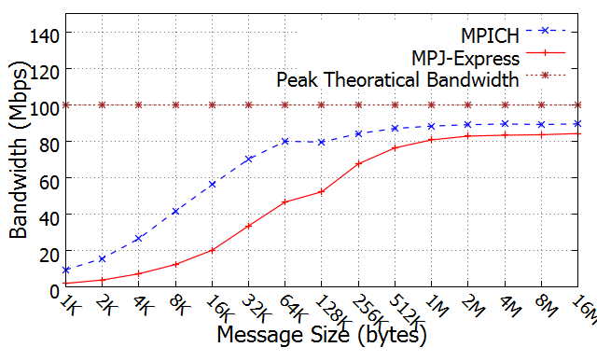
Cluster Evaluation [Network]
Comparison b/w message passing libraries (MPI vs. MPJ)
Baseline for other distributed memory benchmarks
MPICH performs better than MPJ
Small messages ~80%
Large messages ~9%
Poor MPJ bandwidth caused by
Inefficient JVM support for ARM
Buffering layers overhead in MPJ
MPJ better for larger messages as compared to small ones
Overlapping buffering overhead
Latency Test
Bandwidth Test
Notes:
MPICH vs. MPJ-Express
MPICH badwidth ~80% better for smaller messages (upto 128K)
But reduced to ~9% for large messages (16M)
MPJ-Express suffers in inter-node communication
Additional Buffering layers in MPJ architecture
Native device in next MPJ release can overcome this problem.
MPICH and MPJ-Express is that the messaging protocol changes when the message size reaches 128KB. MPICH and MPJ-Express both use Eager and Rendezvous message delivery protocols. In Eager protocol, no acknowledgement is required by the receiving process and this means that no synchronization is needed. This protocol is useful for smaller messages up to a certain message size. For larger messages, Rendezvous protocol is used. This protocol requires acknowledgements because no assumptions can be made regarding the buffer space that is available for the receiving process [39]. In both MPJ-Express and MPICH, the message limit for Eager protocol is set at 128KB. When the message size reaches 128KB, the MPI/MPJ-Express runtime switches the protocol to Rendezvous [40].

Slide 17
Cluster Evaluation [HPL 1/2]
Standard benchmark for Gflops performance
Used in Top500 and Green500 ranking
Relies on optimization of BLAS library for performance
ATLAS – a highly optimized BLAS library
3-executions
performance difference due to architecture specific compilation
O2 –mach=armv7a –mfloat-abi=hard (Appendix C)
Execution | Optimized BLAS | Optimized HPL | Performance
1 | No | No | 1.0 x
2 | Yes | No | ~ 1.8 x
3 | Yes | Yes | ~ 2.5 x
Notes:
HPL C using 3 different optimization levels
Optimizations based on ARM Cortex-A9 compilation flags (Appendix C)
-O2 –mach=armv7a –mfloat-abi=hard etc.
ATLAS library for BLAS
~25 GFLOPS on Weiser

Slide 18
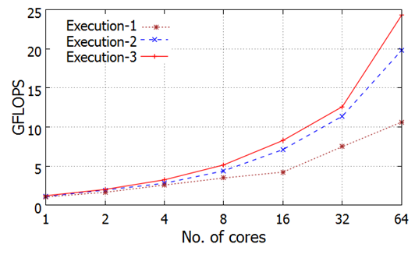
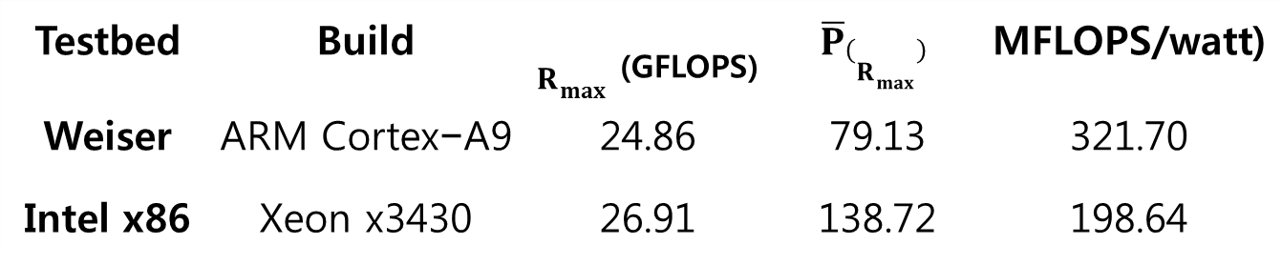
Cluster Evaluation [HPL 2/2]
Energy Efficiency ~321.7 MFlops/Watt
Same as 222nd place Green500
Ex-3 2.5x better than Ex-1
NEON SIMD FPU
Increased double precision
Testbed | Build | $R_{max}$ _{(GFLOPS)} | $$\overline{P}\left(R_{max}\right)$$ | MFLOPS/watt)
Weiser | ARM Cortex−A9 | 24.86 | 79.13 | 321.70
Intel x86 | Xeon x3430 | 26.91 | 138.72 | 198.64
Notes:
Cortex-A9 specific compiler flags resulted in 2.5 times better floating point performance than unoptimized compile

Slide 19
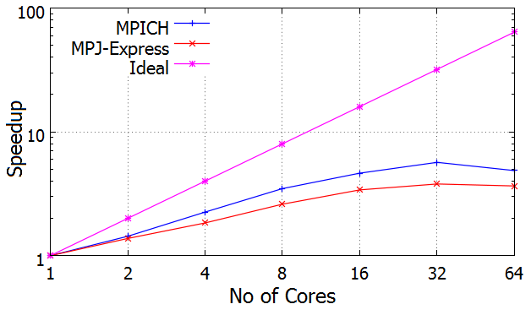
Cluster Evaluation [Gadget-2]
Massively parallel galaxy cluster simulation
MPI and MPJ
Observe the parallel scalability with increasing cores
Good scalability until 32 cores
Comp. to comm. Ratio
load balancing
Communication overhead
Comm. To comp. ratio increase
Network speed and Topology
Small data size due to memory constraint
Good speedup for limited no. of cores
Gadget-2 Cluster Formation Simulation
276,498 bodies
Serial run ~30 hours
64 cores run ~8.5 hours
Notes:
MPJ version of Gadget-2 perform slower than MPICH based implementation due to higher communication between particles residing on non-local nodes.
Galaxies cluster formation simulation of early universe
Massively parallel N-Body algorithms
276,498 particles (bodies)
Serial simulation time 30 hours
64 cores run ~8.5 hours

Slide 20
Cluster Evaluation [NPB 1/3]
Two implementations of NPB
NPB-MPJ (using MPJ-Express)
NPB-MPI (using MPICH)
Four kernels
Conjugate Gradient (CG), Fourier Transform (FT), Integer Sort (IS), Embarrassingly Parallel (EP)
Two application classes of kernels
Memory Intensive kernels
Computation Intensive kernels
Notes:
The communication-oriented NAS kernels, such as CG (unstructured grid computation) and IS (random memory access), are iterative problem solvers that put significant loads on the memory and the network during each iteration. Thus, the memory bandwidth and network latency are crucial to their performance levels. Since CG and IS are communication-intensive kernels, their levels of scalability depend heavily on the communication primitives in the message passing libraries.

Slide 21
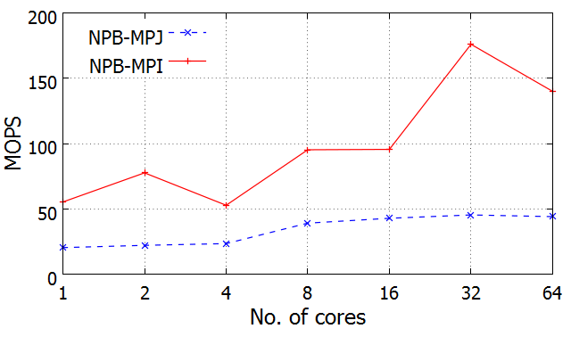
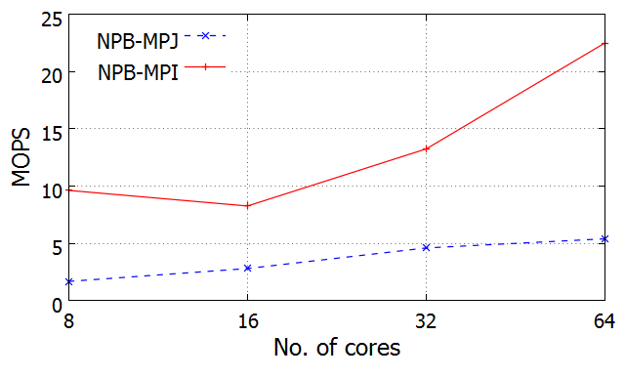
Cluster Evaluation [NPB 2/3]
Communication Intensive Kernels
Conjugate Gradient (CG)
44.16 MOPS vs. 140.02 MOPS
Integer Sort (IS)
Smaller datasets (Class A)
5.39 MOPS vs. 22.49 MOPS
Memory and n/w bandwidth
Internal memory management of MPJ
Buffer creation during Send() Recv()
Native MPI calls in MPJ can overcome this problem
Not available in this release
NPB Conjugate Gradient Kernel
NPB Integer Sort Kernel
Notes:
The communication-oriented NAS kernels, such as CG (unstructured grid computation) and IS (random memory access), are iterative problem solvers that put significant loads on the memory and the network during each iteration. Thus, the memory bandwidth and network latency are crucial to their performance levels. Since CG and IS are communication-intensive kernels, their levels of scalability depend heavily on the communication primitives in the message passing libraries.

Slide 22
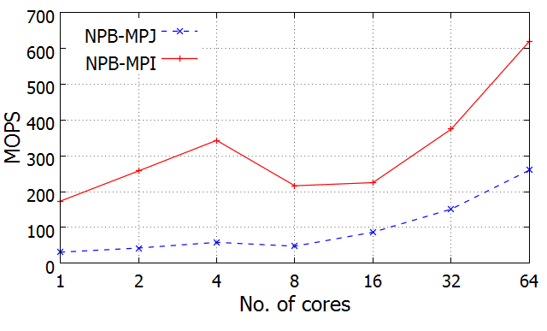
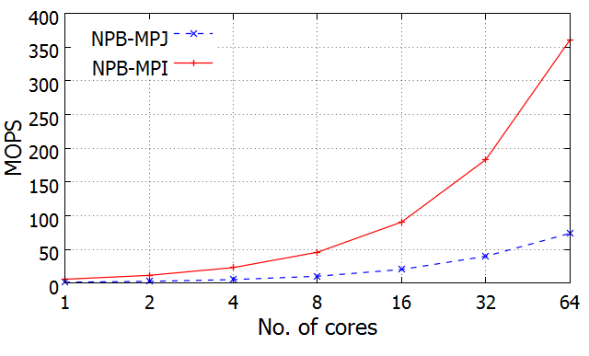
Cluster Evaluation [NPB 1/3]
Computation Intensive Kernels
Fourier Transform (FT)
NPB-MPJ 2.5 times slower than NPB-MPI
259.92 MOPS vs. 619.41 MOPS
Performance drops moving from 4 to 8 nodes
Network congestion
Embarrassingly Parallel (EP)
73.78 MOPS vs. 360.88 MOPS
Good parallel scalability
Minimal communication
Poor performance of NPB-MPJ
Soft-float ABIs
Emulated double precision
NPB Fourier Transform Kernel
NPB Embarrassingly Parallel Kernel
Notes:
The communication-oriented NAS kernels, such as CG (unstructured grid computation) and IS (random memory access), are iterative problem solvers that put significant loads on the memory and the network during each iteration. Thus, the memory bandwidth and network latency are crucial to their performance levels. Since CG and IS are communication-intensive kernels, their levels of scalability depend heavily on the communication primitives in the message passing libraries.

Slide 23
Conclusion [1/2]
We provided a detailed evaluation methodology and insights on single-node and multi-node ARM-HPC
Single node – PARSEC, DB, STREAM
Multi node – Network, HPL, NAS, Gadget-2
Analyzed performance limitations of ARM on HPC benchmarks
Memory bandwidth, clock speed, application class, network congestion
Identified compiler optimizations for better FPU performance
2.5x better than un-optimized BLAS in HPL
321 Mflops/W on Weiser
Analyzed performance of C and Java based HPC libraries on ARM SoC cluster
MPICH – ~2 times increased performance
MPJ-Express – inefficient JVM, communication overhead
Notes:
ARM processors have the potential for Petascale and Exascale HPC industry
Low power consumption
Cost and Cooling
Good scalability and floating point performance
Scientific libraries and compilers should be optimized for ARM architecture
Better support for Java is needed on ARM
Java native overhead
Unoptimized JVM
Virtualization support need to be added as new ARM processors (Cortex-A15) targets server industry

Slide 24
Conclusion [2/2]
We conclude that ARM processors can be used in small to medium sized HPC clusters and data-centers
Power consumption
Ownership and maintenance cost
ARM SoCs show good energy efficiency and parallel scalability
DB transactions
Embarrassingly parallel HPC applications
Java based programing models perform relatively poor on ARM
Java native overhead
Unoptimized JVM for ARM
ARM specific optimizations are needed in existing software libraries

Slide 25
Research Output
International Journal
Jahanzeb Maqbool, Sangyoon Oh, Geoffrey C. Fox “Evaluating Energy Efficient HPC Cluster for Scientific Workloads," Concurrency and Computation: Practice and Experience.(SCI indexed, IF: 0.845) – under review
Domestic Conference
Jahanzeb Maqbool, Permata Nur Rizki Sangyoon Oh, “Comparing Energy Efficiency of MPI and MapReduce on ARM based Cluster,” 49th Winter Conference, Korea Society of Computer and Information (KSCI), No. 22, Issue 1 (한국컴퓨터정보학회 동계학술대회 논문집 제22권 제1호) (2014. 1). (2014: 1) Best Paper Award.

Slide 26
References [1/3]
[1] Top500 list, http://www.top500.org/ (Cited in Aug 2013). [2] P. Kogge, K. Bergman, S. Borkar, D. Campbell, W. Carson, W. Dally, M. Denneau, P. Franzon, W. Harrod, K. Hill, et al., Exascale computing study: Technology challenges in achieving exascale systems.
[3] ARM processors, http://www.arm.com/products/processors/index.php (Cited in 2013). [4] D. Jensen, A. Rodrigues, Embedded systems and exascale computing, Computing in Science & Engineering 12 (6) (2010) 20–29.
[5] L. Barroso, U. Hölzle, The datacenter as a computer: An introduction to the design of warehouse-scale machines, Synthesis Lectures on Computer Architecture 4 (1) (2009) 1–108.
[6] N. Rajovic, N. Puzovic, A. Ramirez, B. Center, Tibidabo: Making the case for an arm based hpc system.
[7] N. Rajovic, N. Puzovic, L. Vilanova, C. Villavieja, A. Ramirez, The low-power architecture approach towards exascale computing, in: Proceedings of the second workshop on Scalable algorithms for large-scale systems, ACM, 2011, pp. 1–2.
[8] N. Rajovic, P. M. Carpenter, I. Gelado, N. Puzovic, A. Ramirez, M. Valero, Supercomputing with commodity cpus: are mobile socs ready for hpc? , in: Proceedings of SC13: International Conference for High Performance Computing, Networking, Storage and Analysis, ACM, 2013, p. 40.
[9] Z. Ou, B. Pang, Y. Deng, J. Nurminen, A. Yla-Jaaski, P. Hui, Energy-and cost-efficiency analysis of arm-based clusters, in: Cluster, Cloud and Grid Computing (CCGrid), 2012 12th IEEE/ACM International Symposium on, IEEE, 2012, pp. 115–123.
[10] A. Bhatele, P. Jetley, H. Gahvari, L. Wesolowski, W. D. Gropp, L. Kale, Architectural constraints to attain 1 exaflop/s for three scientific application classes, in: Parallel & Distributed Processing Symposium (IPDPS), 2011 IEEE International, IEEE, 2011, pp. 80–91.
[11] MPI home page, http://www.mcs.anl.gov/research/projects/mpi/ (Cited in 2013). [12] M. Baker, B. Carpenter, A. Shafi, Mpj express: towards thread safe java hpc, in: Cluster Computing, 2006 IEEE International Conference on, IEEE, 2006, pp. 1–10.
[13] P. Pillai, K. Shin, Real-time dynamic voltage scaling for low-power embedded operating systems, in: ACM SIGOPS Operating Systems Review, Vol. 35, ACM, 2001, pp. 89–102.
[14] S. Sharma, C. Hsu, W. Feng, Making a case for a green500 list, in: Parallel and Distributed Processing Symposium, 2006. IPDPS 2006. 20th International, IEEE, 2006, pp. 8–pp.
[15] Green500 list, http://www.green500.org/ (Last visited in Oct 2013).
[16] B. Subramaniam, W. Feng, The green index: A metric for evaluating system-wide energy efficiency in hpc systems, in: Parallel and Distributed Processing Symposium Workshops & PhD Forum (IPDPSW), 2012 IEEE 26th International, IEEE, 2012, pp. 1007–1013.
[17] Q. He, S. Zhou, B. Kobler, D. Duffy, T. McGlynn, Case study for running hpc applications in public clouds, in: Proceedings of the 19th ACM International Symposium on High Performance Distributed Computing, ACM, 2010, pp. 395–401.
[18] D. Andersen, J. Franklin, M. Kaminsky, A. Phanishayee, L. Tan, V. Vasudevan, Fawn: A fast array of wimpy nodes, in: Proceedings of the ACM SIGOPS 22nd symposium on Operating systems principles, ACM, 2009, pp. 1–14.
[19] V. Vasudevan, D. Andersen, M. Kaminsky, L. Tan, J. Franklin, I. Moraru, Energy-efficient cluster computing with fawn: workloads and implications, in: Proceedings of the 1st International Conference on Energy-Efficient Computing and Networking, ACM, 2010, pp. 195–204.
[20] K. Fürlinger, C. Klausecker, D. Kranzlmüller, Towards energy efficient parallel computing on consumer electronic devices, Information and Communication on Technology for the Fight against Global Warming (2011) 1–9.

Slide 27
References [2/3]
[21] P. Stanley-Marbell, V. C. Cabezas, Performance, power, and thermal analysis of low-power processors for scale-out systems, in: Parallel and Distributed Processing Workshops and Phd Forum (IPDPSW), 2011 IEEE International Symposium on, IEEE, 2011, pp. 863–870.
[22] E. L. Padoin, D. A. d. Oliveira, P. Velho, P. O. Navaux, Evaluating performance and energy on arm-based clusters for high performance computing, in: Parallel Processing Workshops (ICPPW), 2012 41st International Conference on, IEEE, 2012, pp. 165–172.
[23] K. L. Keville, R. Garg, D. J. Yates, K. Arya, G. Cooperman, Towards fault-tolerant energy-efficient high performance computing in the cloud, in: Cluster Computing (CLUSTER), 2012 IEEE International Conference on, IEEE, 2012, pp. 622–626.
[24] M. Jarus, S. Varrette, A. Oleksiak, P. Bouvry, Performance evaluation and energy efficiency of high-density hpc platforms based on intel, amd and arm processors, in: Energy Efficiency in Large Scale Distributed Systems, Springer, 2013, pp. 182–200.
[25] Sysbench bechmark, http://sysbench.sourceforge.net/ (Cited in August 2013).
[26] NAS parallel benchmark, https://www.nas.nasa.gov/publications/npb.html (Cited in 2014).
[28] V. Springel, The cosmological simulation code gadget-2, Monthly Notices of the Royal Astronomical Society 364 (4) (2005) 1105–1134.
[29] C. Bienia, Benchmarking modern multiprocessors, Ph.D. thesis, Princeton University (January 2011).
[30] C. Bienia, S. Kumar, J. P. Singh, K. Li, The parsec benchmark suite: Characterization and architectural implications, Tech. Rep. TR-811-08, Princeton University (January 2008).
[31] High Performance Linpack, http://www.netlib.org/benchmark/hpl/ (Cited in 2013).
[32] R. Ge, X. Feng, H. Pyla, K. Cameron, W. Feng, Power measurement tutorial for the green500 list, The Green500 List: Environmentally Responsible Supercomputing.
[33] G. L. Taboada, J. Touriño, R. Doallo, Java for high performance computing: assessment of current research and practice, in: Proceedings of the 7th International Conference on Principles and Practice of Programming in Java, ACM, 2009, pp. 30–39.
[34] A. Shafi, B. Carpenter, M. Baker, A. Hussain, A comparative study of java and c performance in two large-scale parallel applications, Concurrency and Computation: Practice and Experience 21 (15) (2009) 1882–1906.
[35] http://wrapper.tanukisoftware.com/doc/english/download.jspJava service wrapper, (Last visited in October 2013). http://wrapper.tanukisoftware.com/doc/english/download.jsp
[36] Sodan, Angela C., et al. "Parallelism via multithreaded and multicore CPUs."Computer 43.3 (2010): 24-32.
[37] Michalove, A. "Amdahls Law.” Website: http://home.wlu.edu/~whaleyt/classes/parallel/topics/amdahl.html (2006).
[38] R. V. Aroca, L. M. Garcia Gonçalves, Towards green data-centers: A comparison of x86 and arm architectures power efficiency, Journal of Parallel and Distributed Computing.
[39] https://computing.llnl.gov/tutorialsMpi performance topics, (Last visited in October 2013). https://computing.llnl.gov/tutorials
[40] MPJ guide, http://mpj-express.org/docs/guides/windowsguide.pdf (Cited in 2013). [41] Arm gcc flags, http://gcc.gnu.org/onlinedocs/gcc/ARM-Options.html (Cited in 2013).
[42] HPL problem size, http://www.netlib.org/benchmark/hpl/faqs.html (Cited in 2013). [43] J. K. Salmon, M. S. Warren, Skeletons from the treecode closet, Journal of Computational Physics 111 (1) (1994) 136–155.
[44] D. A. Mallon, G. L. Taboada, J. Touriño, R. Doallo, NPB-MPJ: NAS Parallel Benchmarks Implementation for Message-Passing in Java, in: Proc. 17th Euromicro Intl. Conf. on Parallel, Distributed, and Network-Based Processing (PDP’09), Weimar, Germany, 2009, pp. 181–190.

Slide 28
Use of ARM Multicore Cluster for High Performance Scientific Computing
Thank You
Q&A

